Slide 1

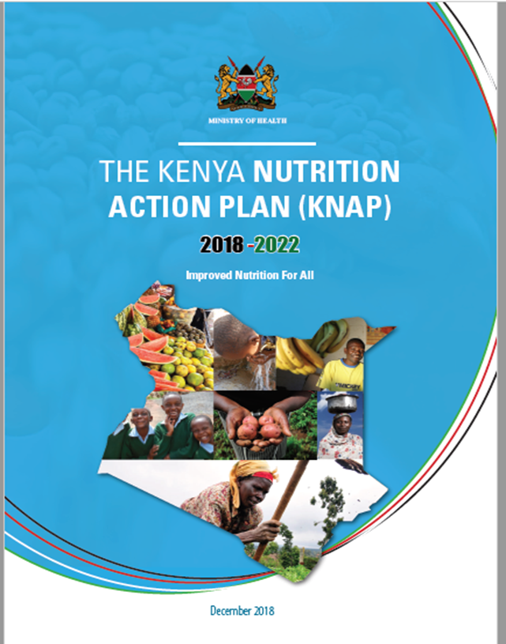

Overview of the Kenya Nutrition Action 2018 -2022
By Veronica Kirogo
Head, Division of Nutrition and Dietetics
Ministry of Health

Slide 2
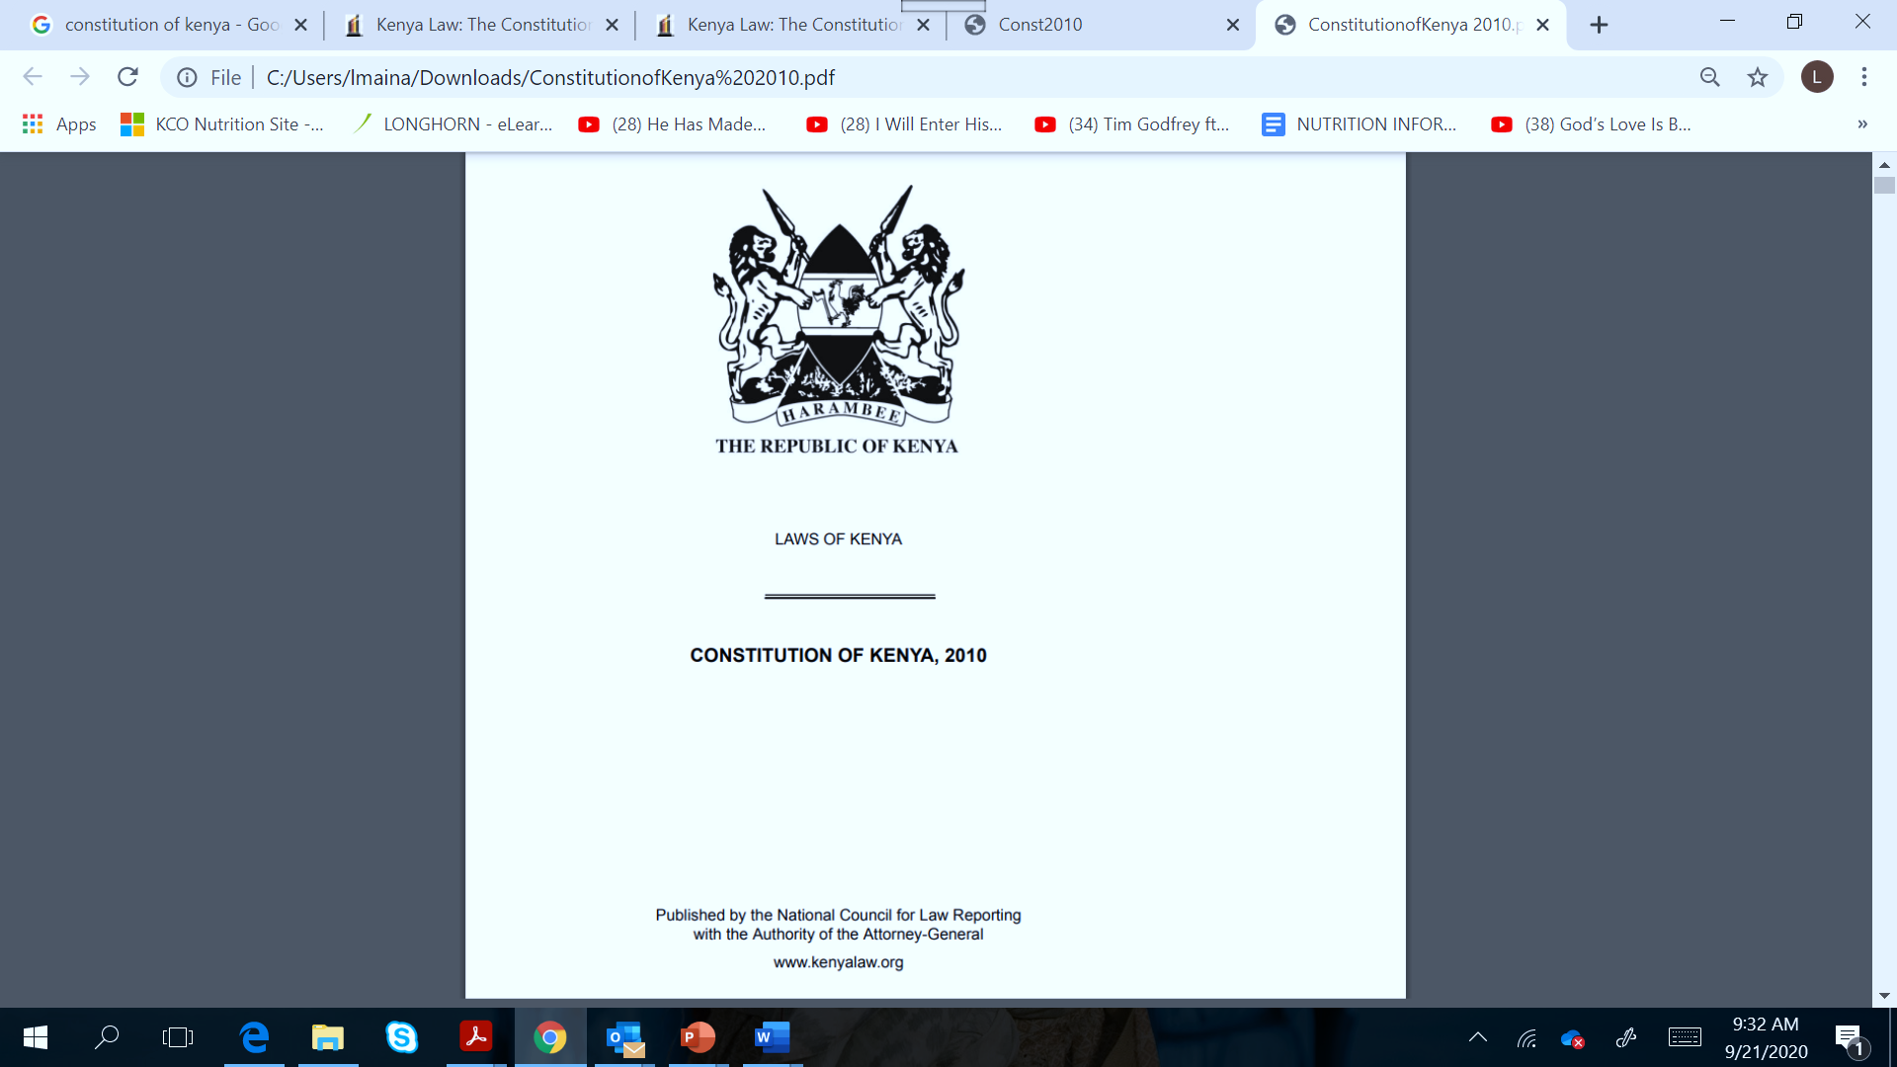

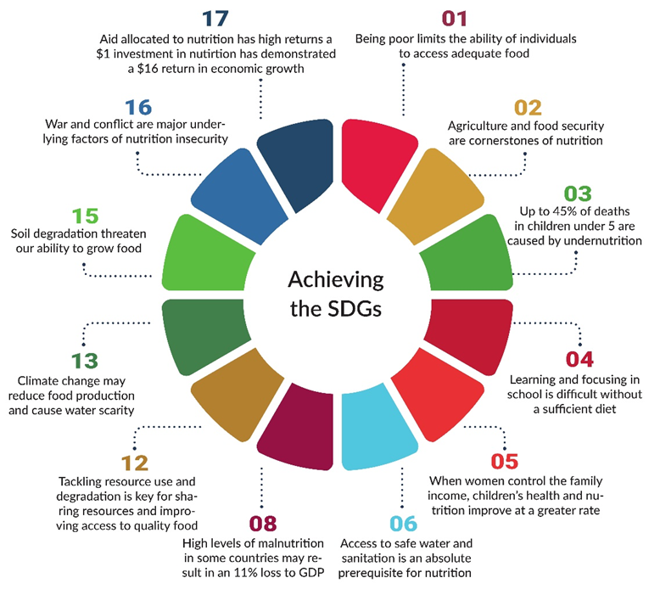
Nutrition Situation: why does it matter?
2010
The Constitution of Kenya (2010) guarantees:
Government is committed to creating an enabling environment for citizens to realize these rights as evidenced in Vision 2030
2030
Despite this constitutional rights; malnutrition is a major challenge threatening Kenya’s achievement of Vision 2030 and other targets
Every child the right to basic nutrition (article 53 1c)
Every person the right to be free from hunger and to have adequate food of acceptable quality (article 43 1c)
2030
Optima nutrition is essential for achievement od SDGs
A multi-sectoral nutrition security approach is necessary for success

Slide 3
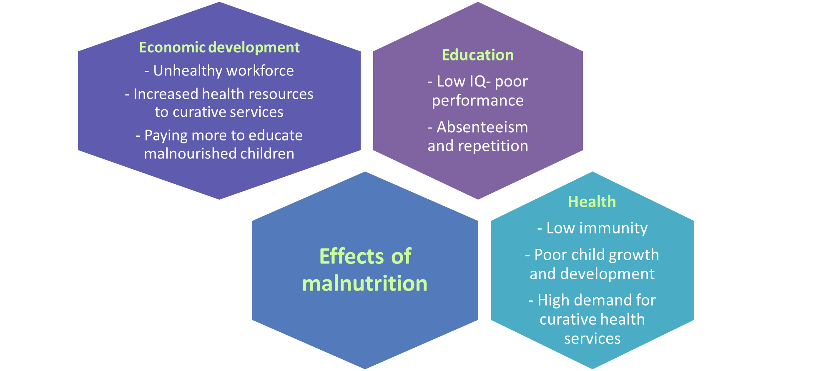
Nutrition Situation: why does it matter?
Every dollar invested has the potential to result in $22 in economic returns in Kenya.
Scaling-up 11 key nutrition specific - interventions in Kenya would cost $76million - 5,000 lives saved, and almost 700,000 cases of stunting averted.
Could increase economic productivity by $458 million per year over the productive lives of the beneficiaries.

Slide 4
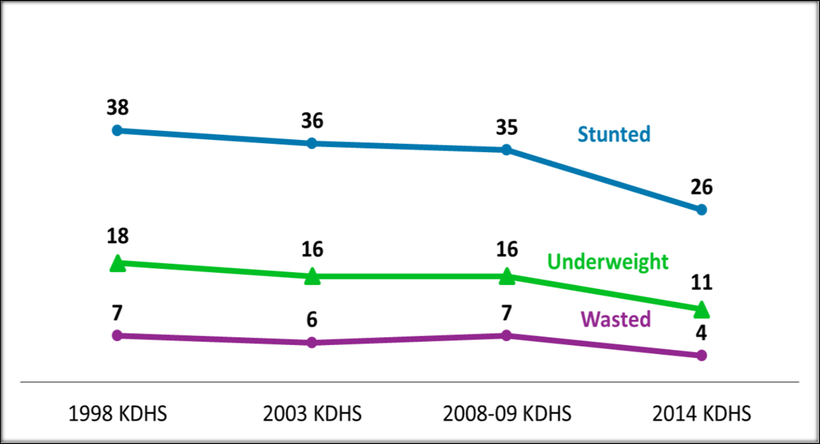
National Trends of Malnutrition among Children <5 years?
4.1% are overweight & obese
2014 KDHS

Slide 5
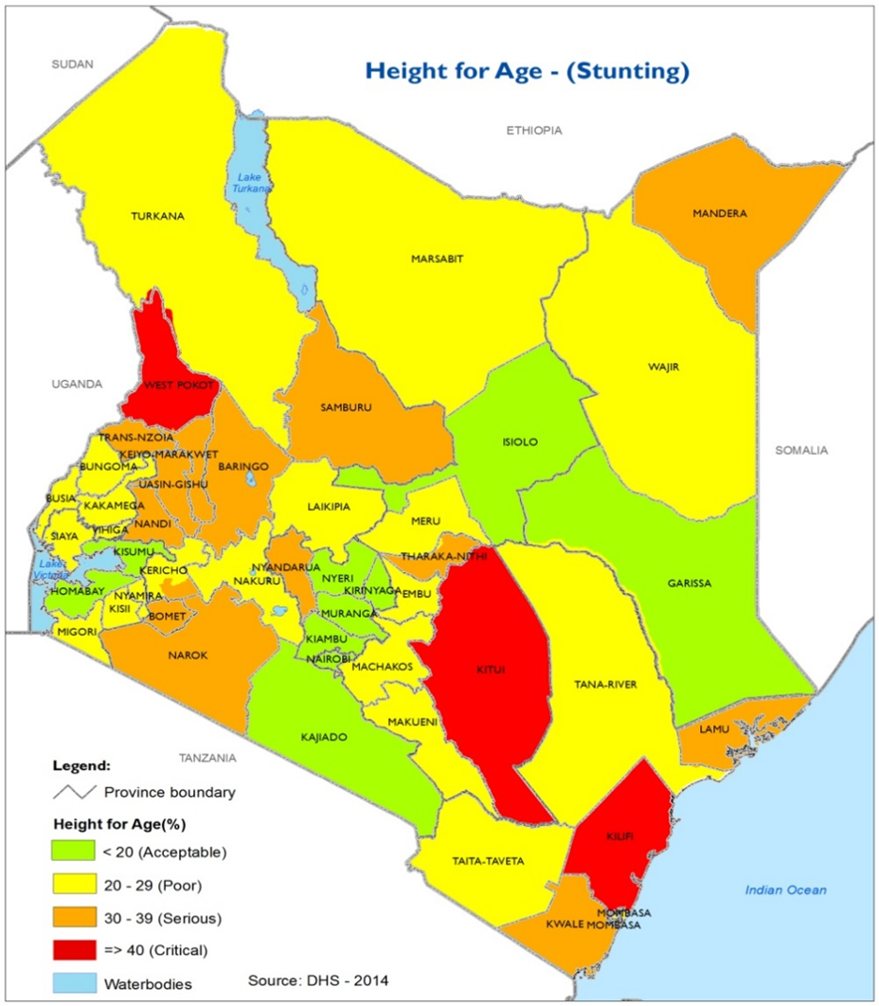
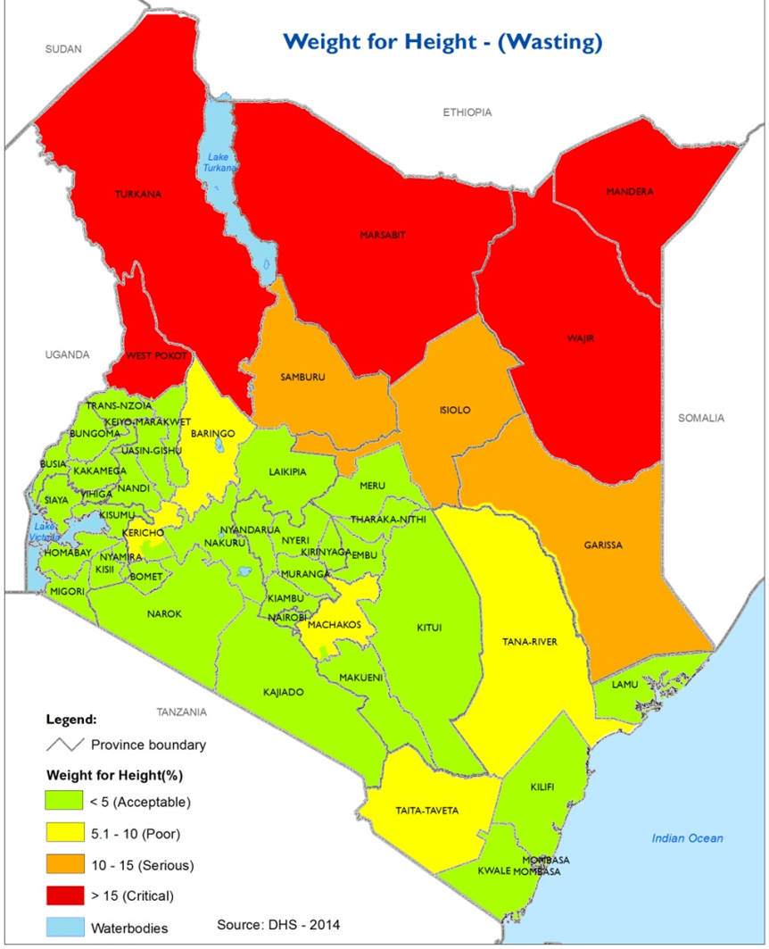
Stunting, Wasting, Underweight among Children <5 years by county
Regional disparities exist in the distribution of malnutrition
Some counties experience all forms of malnutrition indicating chronic issues
Notes:
West Pokot, Kitui and Kilifi had high stunting rates
Trukan, Marsabit, Mandera, Wajir, Marsabit, west Pokot has high wasting rates

Slide 6
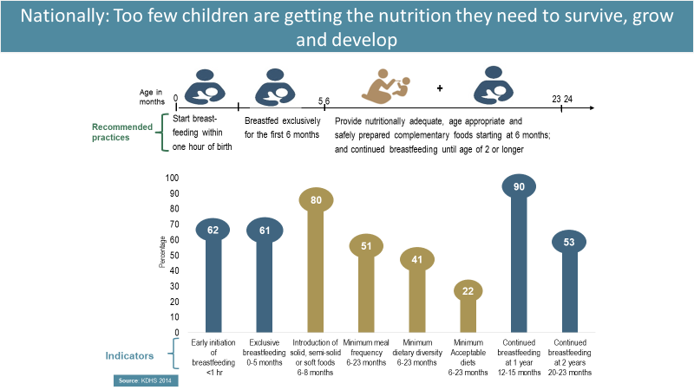
Nationally, too few children are getting the nutrition they need to survive, grow and develop

Slide 7
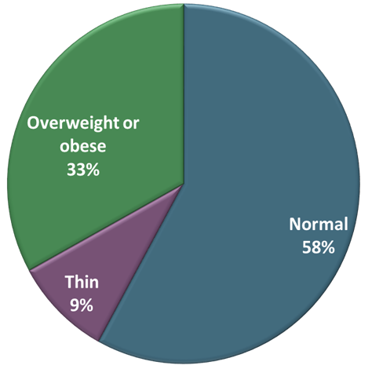
Nutritional status of women
Percent of women age 15-49
Overweight and obesity among women of reproductive age is 33%,
  urban (43%) rural areas (26%)
Proportion of women who are overweight and obese increased from 23% in 2003 to 33% in 2014
9% of women are thin, women in arid and semi-arid (ASAL) areas more affected
Double burden of malnutrition
*Data source KDHS 2014

Slide 8
The Kenya nutrition Action Plan 2018 - 2022
Evidence-based five-year strategic action plan that seeks to address the triple burden of malnutrition in Kenya in all its forms and for all ages
This is 2nd Nutrition Action Plan for implementing Kenya Food and Nutrition Security Policy
Builds on success, limitations and opportunities of 2012-2017 NNAP
Notes:
TARGET AUDIENCE FOR THE KNAP
While many constituencies will benefit from the KNAP, the target audience includes health care planners and policy makers at both national and county level, global and national decision makers, nutrition-sensitive sectors, nutrition officers and managers at all levels, donors, development partners, NGOs, civil society organizations, faith-based organizations, the private sector, academia, research institutions, the media and the Kenyan public at large. This will enable them to understand what the government is doing to ensure optimal nutrition for all Kenyans and what they can do individually to contribute to the effort.

Slide 9
Development of KNAP: Key milestones

Slide 10

Learning from 2012-2017 NNAP
KNAP Development Process
NNAP provided :
  One agreed plan and vision for nutrition
  One coordinating authority: enhanced government leadership
  One agreed nutrition M&E framework
Improved coordination of stakeholders,
harmonized approach to implementation and monitoring of nutrition programs.
Improved policy environment
Improved capacity development
Strengthened advocacy and social mobilization
Improvement in nutrition indicators at population level
Achievement

Slide 11

Learning from 2012-2017 NNAP
KNAP Development Process
Technical capacity gaps: related to number and skills mix of nutrition staff especially in specialized
Structural capacity gaps: related to distance and access to services, CHS not well developed, poor archiving of data and information, programmes not at scale
Financing gaps: high cost of nutrition commodities and equipment, inadequate long-term financing with more emergency-oriented funding from government for short-term actions
Coordination and Leadership gaps: low involvement of other sectors, limited linkages; for example, regulatory environmental challenges, advertisements of unhealthy foods
Challenges

Slide 12

Recommendations
KNAP Development Process
Strengthen policy coherence across sectors
Strengthen financing for nutrition
Strengthen multisectoral coordination and collaboration: including strengthening governance and leadership for nutrition across sectors.
Enhance advocacy, communication and social mobilization for nutrition at all levels
Enhance and scale up monitoring and evaluation systems for nutrition at national and county levels
Strengthen capacity development initiatives including infrastructure, products and technologies, commodities, HR management, internships, technical trainings including specialization
Strengthen partnerships and collaboration with private sector.
Enhance systems for evidence generation, knowledge management and utilization
Enhance and scale up population-level nutrition awareness initiatives while ensuring life-course approach is implemented
Enhance and strengthen regulatory and compliance monitoring for nutrition commodities and allied products
Recommendations/ lessons learnt

Slide 13

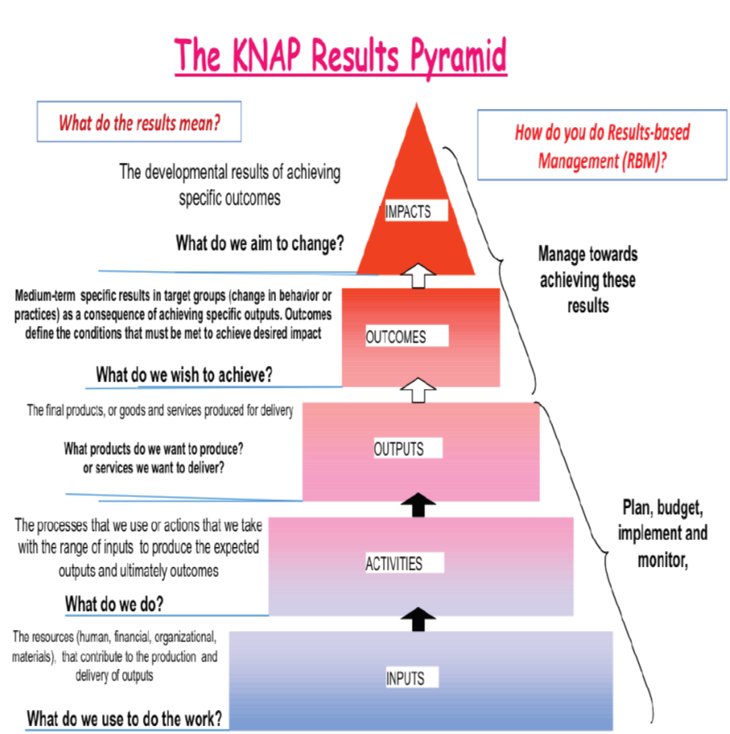
Result based nutrition plan
Overall expected result for KNAP is for all Kenyans to achieve optimal nutrition for a healthier and better quality life and improved productivity for the country’s accelerated social and economic growth
Key strategies
Life-course approach to nutrition programming
Sectoral and multisectoral approaches
Integration which takes into account the various platforms in place to deliver nutrition
Capacity strengthening for implementation of nutrition services
Advocacy, communication and social mobilization: for increased political goodwill for increased investments and raising population-level awareness
Equity and human rights
Resilience and risk-informed programming
Monitoring, evaluation, learning and accountability
Sustainability: empowerment for sustainability of results
Notes:
Strategies
Life-course approach to nutrition programming: a holistic approach to nutrition issues for all population groups
Coordination and partnerships: sectoral and multisectoral approaches to enhance programming across various levels and sectors, and within the SUN movement platforms
Integration which takes into account the various platforms in place to deliver nutrition e.g. health centres and schools
Capacity strengthening for implementation of nutrition services targeting service providers and related systems
Advocacy, communication and social mobilization: acknowledging that nutrition improvements require political goodwill for increased investments and raising population-level awareness
Equity and human rights
Resilience and risk-informed programming: focus on anticipating, planning and reducing disaster risks to effectively protect persons, communities, livelihoods and health
Monitoring, evaluation, learning and accountability: promotion of use of the triple A (assessment, analysis & action) cyclic process to provide feedback, learn lessons and adjust strategy as appropriate
Sustainability: empowerment for sustainability of results – the need to ensure predictable flow of resources, develop technical and managerial capacity of implementers, motivate implementers, ensure vertical and horizontal linkages, and gradual exit when exiting an intervention.

Slide 14
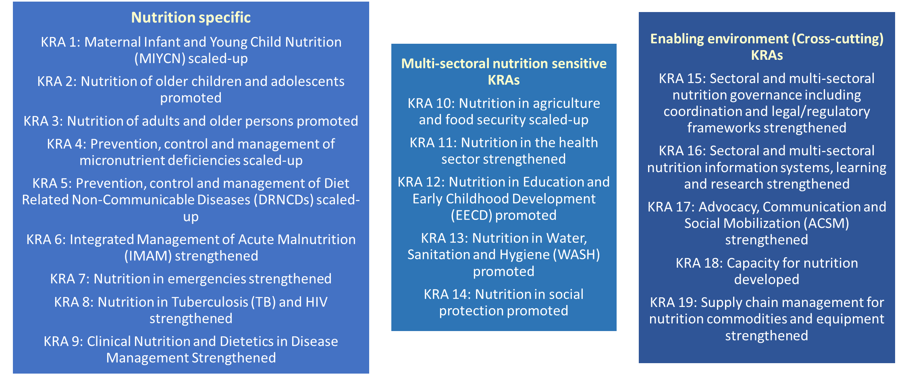
Result based nutrition plan
To achieve the expected result a total of 19 key result areas (KRAs) have been defined

Slide 15

Estimated Cost of the 2018-2022
The total cost to achieve the 19 key results over the next five years is KES 38.4 billion (US$ 379.9 million)

Slide 16
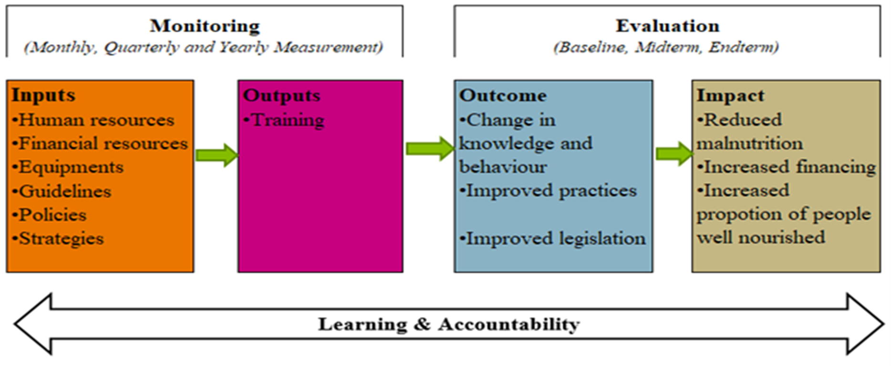
KNAP MEAL Logical Framework
MEAL will facilitate tracking and evaluation of performance of set targets
Serve as an accountability and learning framework for nutrition stakeholders
Provides a summary of select results and indicators that will be mutually tracked and reported on by all sectors responsible for the implementation of KNAP referred to as Common Result and Accountability Framework (CRAF)
Notes:
MEAL: MONITORING EVALUATION ACCOUNTABILITY AND LEARNING FRAMEWORK

Slide 17
Partnerships and Coordination for KNAP
Sector wide partnership
Sectoral and multisectoral linkages

Slide 18


“Stunted growth leads to a stunted economy” Former Tanzanian president Jakaya Kikwete
Call for Resources to Implement the KNAP
Strong Partnerships
Call to action

Slide 19

KEY ASKS
Commitment to development of Costed County Nutrition Action Plans
Commitment to joint implementation of the County Nutrition Action Plans ( by all line ministries and partners)
Commitment to Nutrition targets Monitoring and Reporting as spelt out in the Kenya Nutrition Action Plan
Commitment to financing of Nutrition Interventions including in the Supplementary budget processes

Slide 20



Thank you for listening

